Slide 1
SCIENCE
Science and technology plays important role in development of human civilization.
The word ‘Science’ comes from latin word ‘Scientia’ meaning knowledge.
It uses two basic tools namely, observation and experimentation.
It may be defined as ‘a systematic body of factual knowledge obtained by the use of scientific methods.

Slide 2
Development of science in the ancient cultures
The Palaeolithic Age
In the Paleolithic period (roughly 2.5 million years ago to 10,000 B.C.), early humans lived in caves or simple huts or tepees and were hunters and gatherers. They used basic stone and bone tools, as well as crude stone axes, for hunting birds and wild animals. They cooked their prey, including woolly mammoths, deer and bison, using controlled fire. They also fished and collected berries, fruit and nuts.
The Paleolithic or Palaeolithic also called the Old Stone Age, is a period in human prehistory distinguished by the original development of stone tools . Paleolithic humans made tools of stone, bone, and wood.
Fire was used by the Lower Paleolithic. hominins Homo erectus and Homo ergaster
Inventions are: The use of fire for light, heat, cooking, the invention of stone weapons, tools such as daggers, spear points, axes, choppers and scrapers, use of spoken language for communication and preservation of culture and religious rituals, inventions of social, political and economic institutions. Shelters from animal skin and plants.

Slide 3
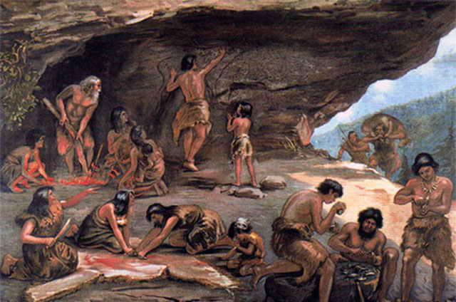
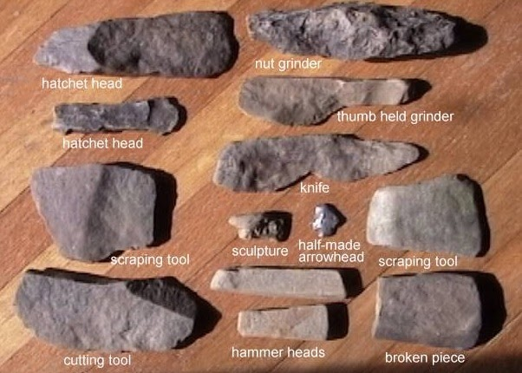

Slide 4
The Neolithic Age
Neolithic stage at different times, but it is generally thought to have occurred sometime about 10,000 BCE. During that time, humans learned to raise crops and keep domestic livestock and were thus no longer dependent on hunting, fishing, and gathering wild plants. Neolithic cultures made more-useful stone tools by grinding and polishing relatively hard rocks rather than merely chipping softer ones down to the desired shape. The cultivation of cereal grains enabled neolithic people to build permanent dwellings and congregate in villages, and the release from nomadism and a hunting gathering economy gave them the time to pursue specialized crafts.
The first evidence of cultivation and animal domestication in southwestern Asia has been dated to roughly 9500 BCE’.

Slide 6
The Urban Revolution
The development of arts, science
The invention of written language for communication, record keeping and the transmission of culture.
Sumerians and Egyptians adopted civilization. Their contribution
in mathematics and science was notable.
Methods were developed for measuring time, distance , area and quantity.

Slide 7
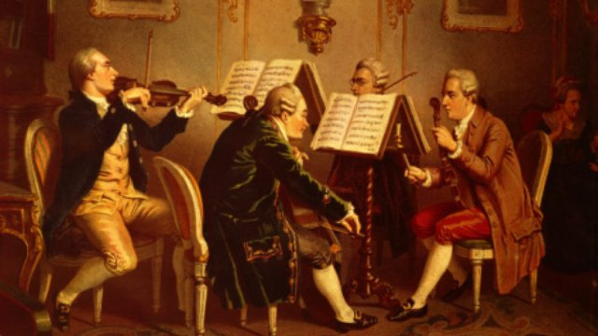
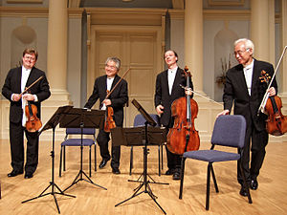

Slide 8
The classical Era
The Classical period itself lasted from approximately 1775 to 1825. The name classical is applied to the period because in art and literature, there was keen interest in, admiration for, and emulation of the classical artistic and literary heritage of Greece and Rome.
Intellectually, this era has also been labeled the Age of Enlightenment. The French and American revolutions in the last quarter of the eighteenth century were stimulated by this new attitude.
The musical scene in the classical period reflected the changes occurring in the society in which the music was being written. This was the first era in music history in which public concerts became an important part of the musical scene. Music was still being composed for the church and the court, but the advent of public concerts reflected the new view that music should be written for the enjoyment and entertainment of the common person.

Slide 9
Contribution to astronomy. Geometry, cosmology.
Idea of Universe was given. (earth, air, water, fire)
Matter is composed of eternal, indivisible, infinitely small substances.
Theory of atom was given. Glimpse of Big Bang.
Pythagoras contribution to mathematics and philosophy.
The development of medicine by Hippocrates.
Aristotle contribution in scientific zoology in classification.
Alexandrian model in geometry.

Slide 10
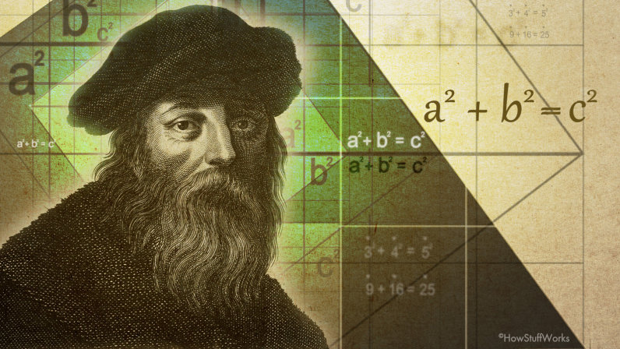
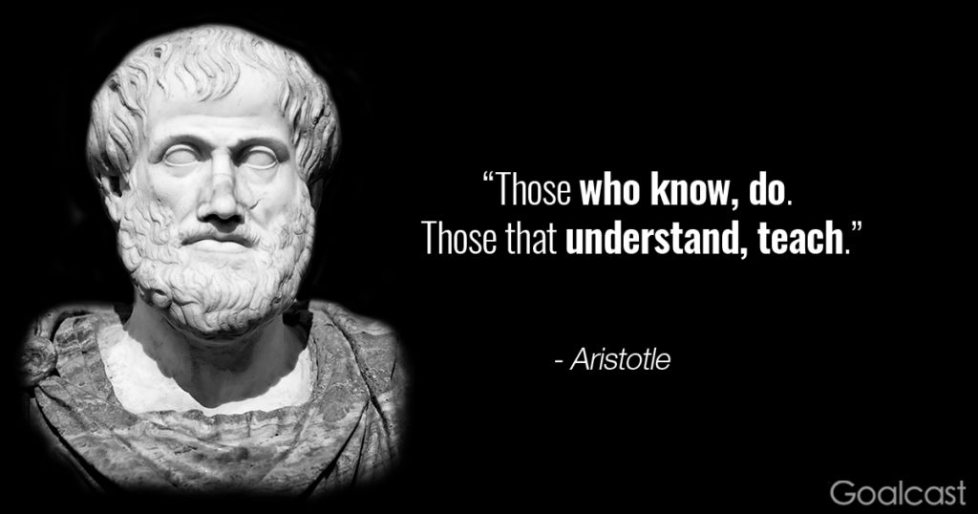

Slide 11
The middle ages ( Medieval era)
In the history of Europe, the Middle Ages or Medieval Period lasted from the 5th to the 15th century. It began with the fall of the Western Roman Empire and merged into the Renaissance and the Age of Discovery.
The early middle ages witnessed the rise of monasticism in the west.
The development of agriculture such as crop rotation, watermills, windmills.
The introduction of papermaking.
The Renaissance
Invention of the printing press
Advances in geography, astronomy, chemistry, physics, mathematics, manufacturing and engineering.
Heliocentric model by Nicolaus Copernicus. (Sun stationary at the centre and earth revolves around it.)
Innovation of telescope, microscope and thermoscope by Galileo Galilei.
Innovations by Kepler about mathematics and astronomy.
Innovations by William Harvey

Slide 12
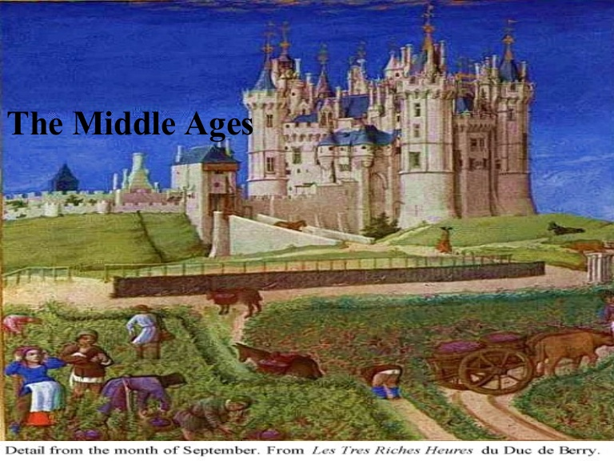
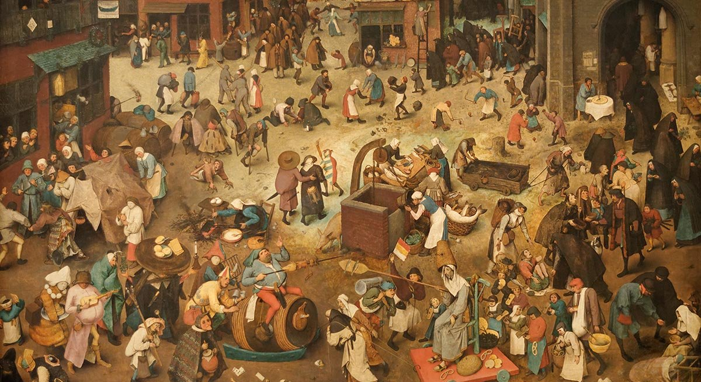

Slide 13
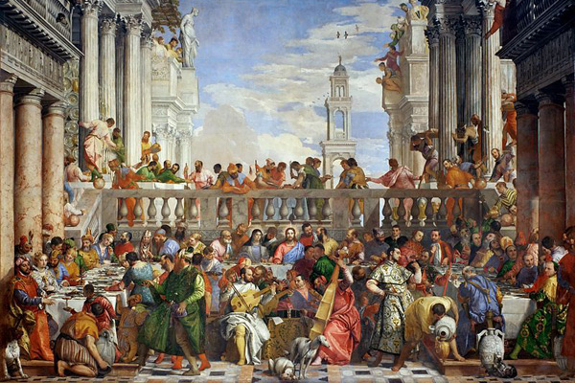
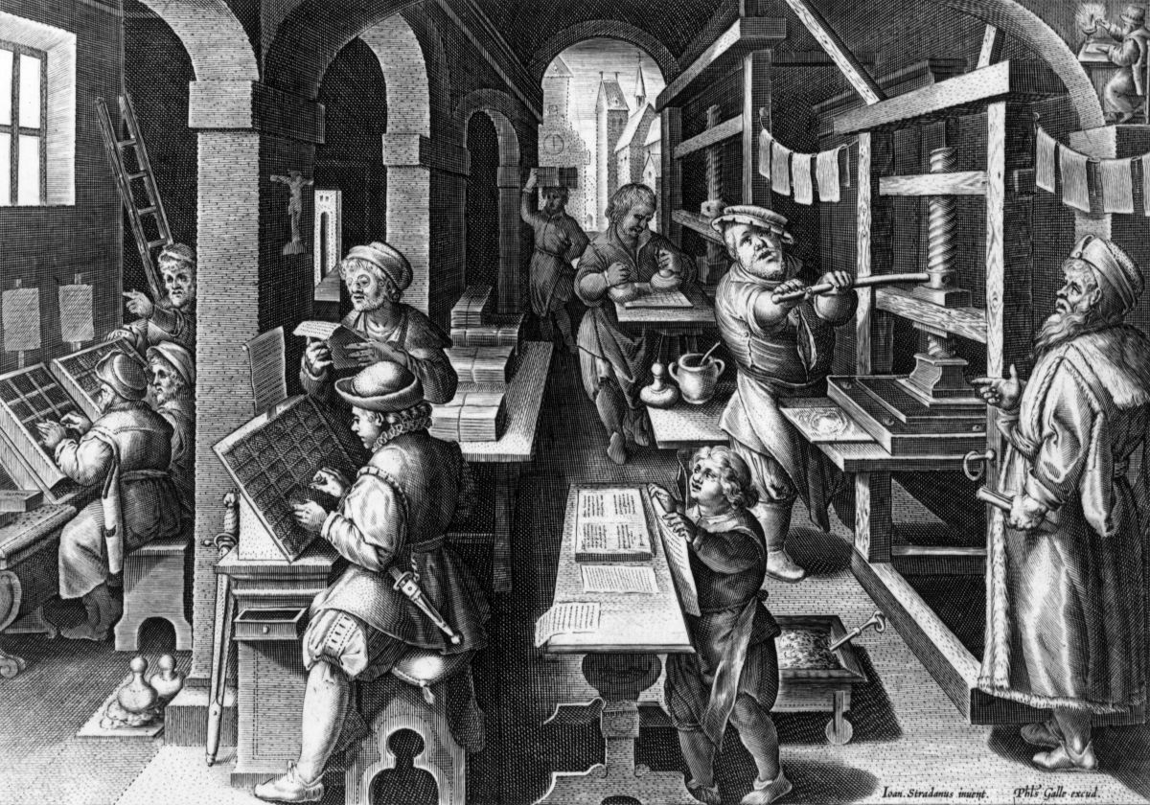

Slide 14
The age of enlightenment
Intellectual movement in 18th century in Europe. Movement provided a framework for the American and French revolutions.
Development of printing press.
Discoveries in different fields. Isaac Newton was a founder of theoretical physics. Charles Darwin developed a modern biology. Louis Pastuer contributed to natural understanding of cellular reproduction.
Contribution of William Harvey towards blood circulation was a great innovation.
Logarithms were introduced .
Development of telescope was also a remarkable change.

Slide 15
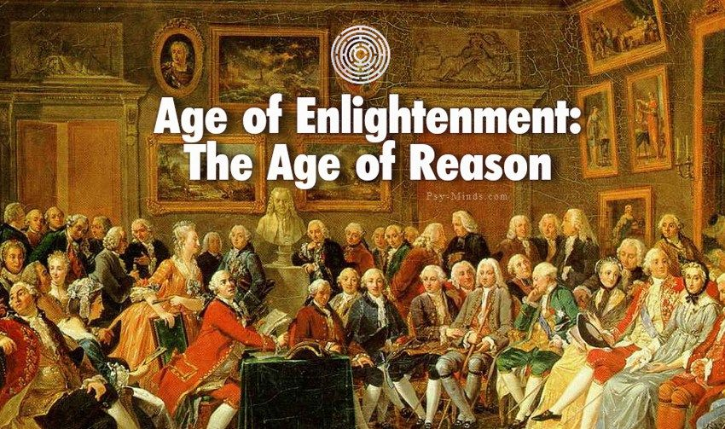
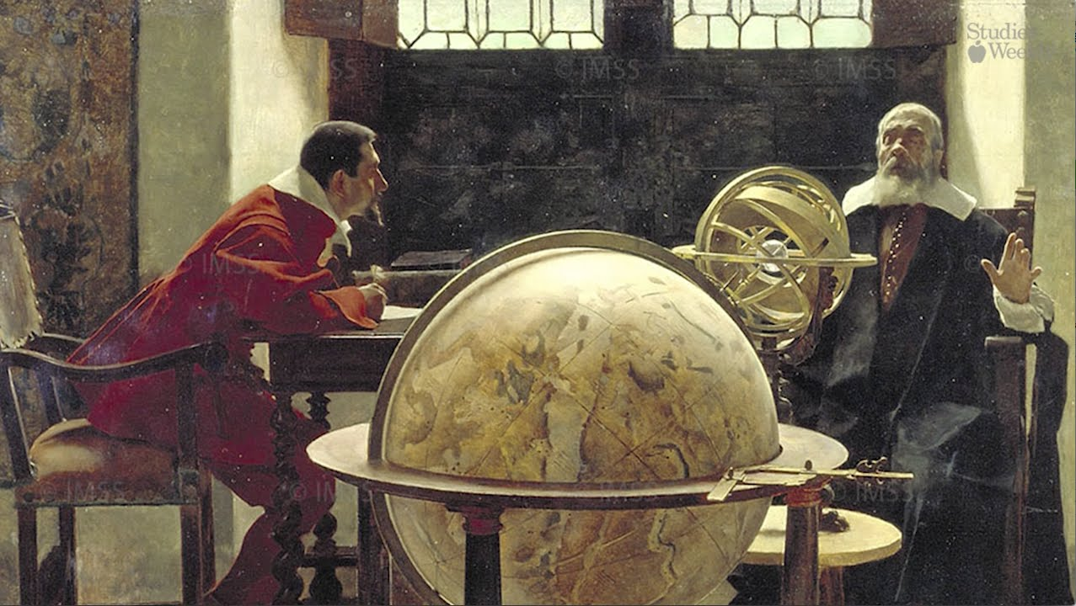

Slide 16
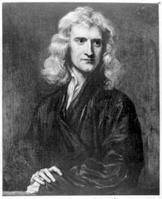
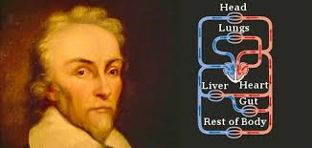
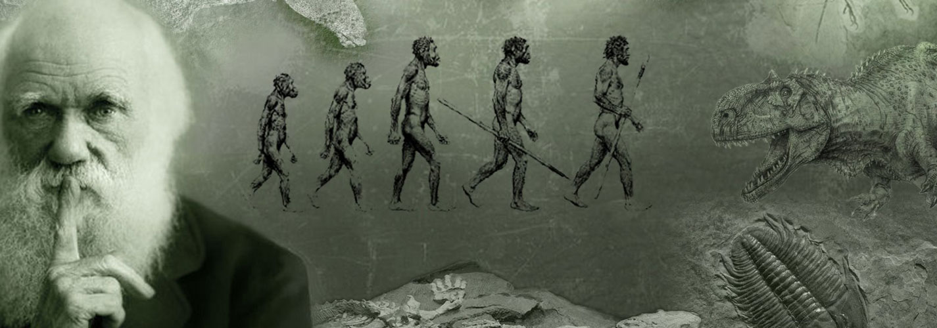
Isaac Newton
William Harvey
Charles Darwin

Slide 17
NATURE AND CHARACTERISTIC OF SCIENCE
1. Objectivity:
Scientific knowledge is objective. Objectivity simple means the ability to see and accept facts as they are, not as one might wish them to be. To be objective, one has to guard against his own biases, beliefs, wishes, values and preferences.
2. Precision:
Scientific knowledge is precise. It is not vague like some literary writing. Precision requires giving exact number or measurement. Science is unbiased knowledge as it makes use of scientific method. It is open to scrutiny by the scientific world.
3. Conclusions of science are reliable, though tentative. Science is always a work in progress, and its conclusions are always tentative. Science's conclusions are not tentative in the sense that they are temporary until we get the real answer. Scientific conclusions are well founded in their factual content and thinking and are tentative only in the sense that all ideas are open to scrutiny.
https://evolution.berkeley.edu/evolibrary/article/0_0_0/nature_06
https://www.yourarticlelibrary.com/science/top-9-main-characteristics-of-science-explained/35060

Slide 18
In science, the tentativeness of ideas such as the nature of atoms, cells, stars or the history of the Earth refers to the willingness of scientists to modify their ideas as new evidence appears.
4. The data of science is facts.
Science deals with facts. The validity of facts is done through observations. It is necessary to collect accurate and relevant data. The evidence is collected by scientific machines. This is called as empirical study.
5. Use of the scientific method
Scientific knowledge is collected by means of scientific method. It is a process by which scientists construct an accurate representation of the world. Scientific method attempts to minimize the bias in the experiment when testing hypothesis or a theory.
6. Systematization
Science is classified and organized in a systematic manner. Classification of knowledge takes place in an orderly manner.
7. No scope for ambiguity
Scientific knowledge is clear and communicable. Science makes use of specific language to express itself, in order to avoid ambiguity.. In advanced sciences, concepts are expressed in the language of mathematics.

Slide 19
8. Imagination and creativity
These two are engines to scientific advance needed to generate ideas. Einstein remarked that imagination is more important than knowledge.
9. Hypothesis ,laws and theories are different
Laws are higher forms of scientific knowledge and express the way the natural world behaves under a particular set of conditions. Scientific theory predicts and explains laws. Hypothesis is a guess.
10. The generation and acceptance of scientific knowledge often takes much time.
Any scientific idea before acceptance has to pass through series of test. The scientist has to correctly analyze the data, convince the community of scientist who have done research in that area about whether they have or have not reached the correct conclusion. This often takes much time.

Slide 20
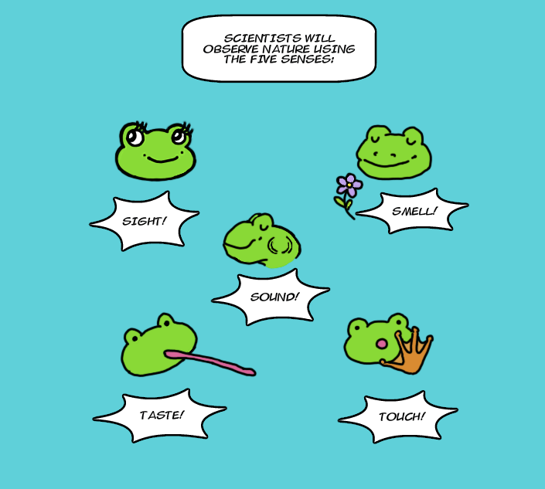

Slide 21
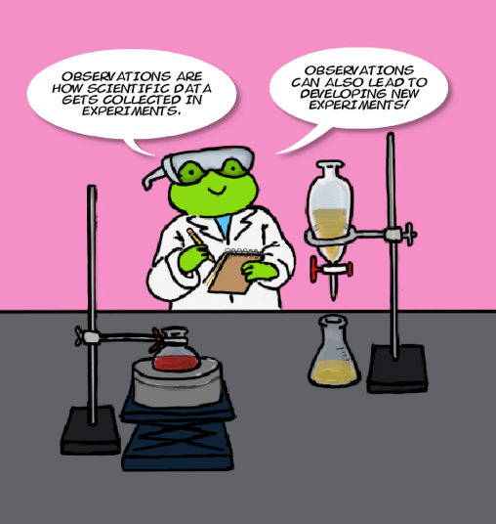

Slide 23
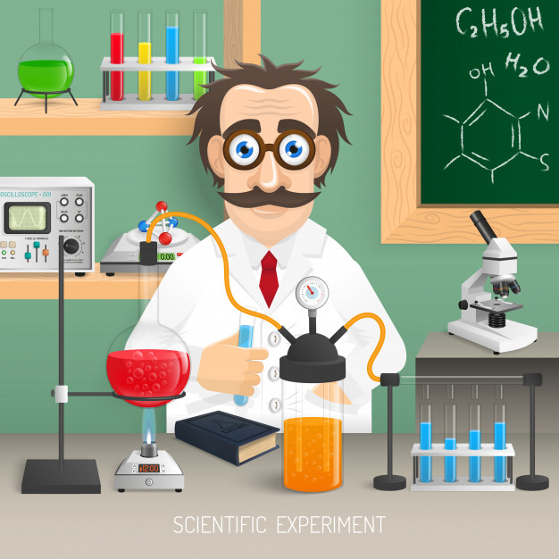

Slide 24
conclusion

Slide 25
Process of Scientific method
1. Ask a Question
From observations of the natural world, we can determine the nature of phenomenon that is interesting to you. The scientific method starts when you ask a question about something that you observe: How, What, When, Who, Which, Why, or Where?
2. Construct a Hypothesis
A hypothesis is an educated guess about how things work. It is an attempt to answer your question with an explanation that can be tested. A good hypothesis allows you to then make a prediction. The hypothesis should predict an outcome.
3. Test Your Hypothesis by Doing an Experiment
Your experiment tests whether your prediction is accurate and thus your hypothesis is supported or not. It is important for your experiment to be a fair test. You conduct a fair test by making sure that you change only one factor at a time while keeping all other conditions the same.
You should also repeat your experiments several times to make sure that the first results was accurate.
4. Conclusion
Creating a conclusion with data gathered in the experiment.

Slide 26
Scientific method
The scientific method is a logical and rational order of steps that scientists must follow. Scientific method helps to organize thoughts and procedures. Method is based on gathering observable empirical and measurable evidence and consists of the collection of data through observation and experimentation and the formulation and testing of hypothesis.
Science is empirical in nature. It is based on observations.

Slide 27
Science and superstitions

Slide 28
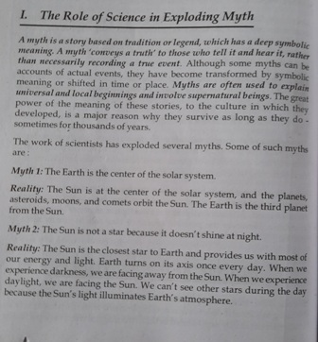

Slide 30
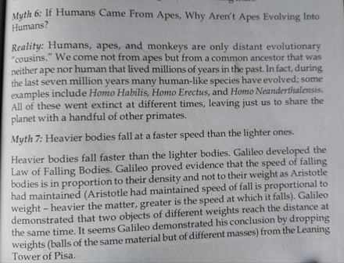

Slide 31
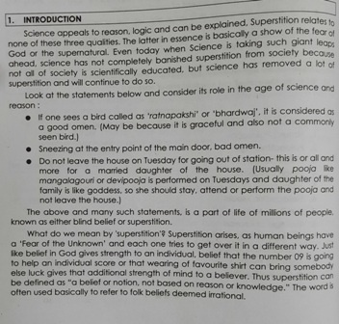
Science and superstitions

Slide 32
Superstitions are self-imposed selfish beliefs, something imaginary yet unimaginable disbelief, or mere beliefs. But science – the most well-known and popular word of this era. Science as is believed to be something realistic which even makes the unreal real; the unachievable achievable.
Some of the superstitions are:
1.Eat curd and sugar before heading out
Eating curd and sugar before stepping out for something new and important is considered to be good luck as the consumption of curd has a cooling effect on the stomach and sugar which is added provides instant glucose which makes your work easier and successful. This combination is indispensable for Indians and its consumption was slowly linked to good luck.
2. Don’t wash or cut hairs on certain days
Washing or cutting hairs on certain days like on Tuesdays or Thursdays are considered to be bad luck but there’s no truth in this as it was one of the water management practices. And moreover, during those days, barbers got a holiday on those days. So, just to give them a holiday people don’t cut hairs on those days.

Slide 33
3. Bathe after attending a funeral ceremony
Earlier bathing was necessary after attending a funeral ceremony but today it’s not like earlier as our ancestors didn’t have vaccinations against smallpox, hepatitis and other deadly diseases. So they came up with this ritual of bathing so as to prevent themselves from infection from the dead body.
4. Lizard falling on human is bad luck It is said to be bad luck but the scientific reasons behind this is that the lizard releases poisonous chemicals from its body in order to protect themselves from enemies and if it falls on human body or food, it is bound to contaminate it. So, bathe is taken after it falls on someone.
5. Using lemons and green chillies to avoid buri nazar
The nimbhu mirchi tadka is one of the commonly visible superstitions among the society whose use is often encouraged due to the qualities of lemon and chillies as they both are rich in different vitamins Ad create certain acidic odour which helps keep away insects. Thus, our ancestors used this as a symbol during ceremonies which now turned into a tadka.

Slide 34
6. Ghosts residing in peepal trees This myth continues to prevail even today. But the scientific reason behind this is that the trees use carbon dioxide during the day and releases oxygen but at night, it is the other way round. So, when you sleep under the tree, the excess carbon dioxide level can make you feel heavy in the fist and suffocated which is associated with the feeling of being possessed by some spirits.
7. Throwing coins in fountains and rivers bring good
Most currencies in ancient times were made of copper and by throwing copper coins into rivers, our forefathers apparently ensured that they were consuming pure water. Science has it that copper has antimicrobial property and it can kill 99.9% of infection-causing bacteria. However, today neither do we use copper coins nor do we drink water directly from the river. This belief has brought in more pollution than good luck.

Slide 35
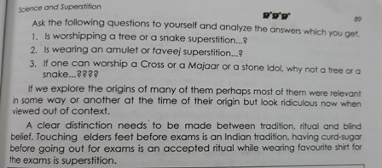
Ask the questions

Slide 36
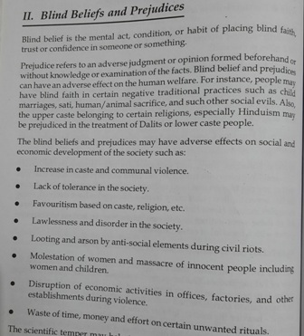

Slide 37
Scientific temper
Jawaharlal Nehru coined the term ‘scientific temper’ in 1946; he defines it as an attitude of logical and rational thinking. An individual is considered to have scientific temper if she or he employs the scientific method when making decisions.
To develop scientific temper, humanism and the spirit of inquiry and reform is one of the fundamental duties of Indian citizens.
It can be cultivated with a sense of enquiry and reform.
Children should be encouraged to question scientific solutions.
Suppression of creativity and scientific ideas in the name of religion, culture and traditions happens in most part of the country. Compromising on scientific advances just because somebody’s religious and cultural sentiments are hurt is against our constitution.
The mental attitude which is behind the method of acquiring reliable and practical knowledge may be called the “Scientific Temper”

Slide 38
Scientific temper involves:
The mental attitude which is behind the method of acquiring reliable and practical knowledge.
Not accepting answers without testing and trial.
Requiring solid information and data and then suitable analysis before accepting anything.
Not accepting views and opinions, simply because traditionally they have accepted these views.
Not observing superstitious practices.
Openness of mind.
Article 51 A of our constitution deals with fundamental duties
which makes it a duty of every citizen to develop a scientific temper.
Secularism, humanism and spirit of enquiry and reforms are directly
related in Scientific temper.

Slide 39
Characteristics of technology
Technology has utilitarian value
Technology is futuristic
Problem solving
Team work
Creativity
Material well being
Technology always has side effects
All technological systems can fail
Intricate relationship
Human presence is an important issue in technology

Slide 40
Role of science and technology in modern living
Agriculture
Food
Clothing
Transport and communication
Better standard of living
Quality of life
Health benefits
Technology in Education
Manufacturing and services

Slide 41
Interrelation between science & technology
Technology is application of scientific knowledge.
It is a process for producing something useful for man’s convenience.
Technologists combine scientific knowledge with practical values.
Development of technology makes new worlds for science to explain.
Scientific knowledge and methodologies provide a major source of input into the development of technological practices and outcomes.

Slide 42
Science v/s technology
SCIENCE | TECHNOLOGY
1.Meaning It is a system of acquiring knowledge based on the scientific method. | It refers to the tools, machinery, modifications that help to solve a problem.
2. Purpose The main purpose of science is to explain the natural world through intellectual and investigative practices that involve observations and experimentation. | The main purpose is to intervene in the world to produce something new. It achieves this through intellectual and design based practices.

Slide 43
3. Goal The goal of science is pursuit of knowledge and understanding for its own sake. | The goal of technology is the creation of artifacts and systems to meet people’s need.
4. Focus It focuses in understanding the natural phenomenon. | It focuses on understanding the man made environment.
5. Development Models Science involves discovery. | It involves design, invention and production.
6. Skills to excel The skills required to excel include experimental and logical skills. | The skills required include design, construction, testing, planning, communication skills etc.

Slide 44
7. Relevance of result Science involves making virtually value free statements. | In technology, the activities are always value- laden.
8.Evaluation Methods It includes analysis, generalization and creation of theories. | It includes analysis and synthesis of design.
9. Mission It relates to the search for and theorizing about the cause. | It relates to the search for and theorizing about new processes.

